Slide 1
The Next Big Thing After Uber: iPark^{TM*}
By: Adam Israfil, Ashean Silva, Chengjun Dong, Mohammed Rahman
*Apple copyright lawsuit pending

Slide 2
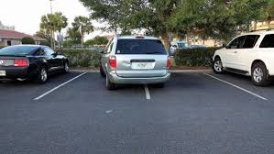
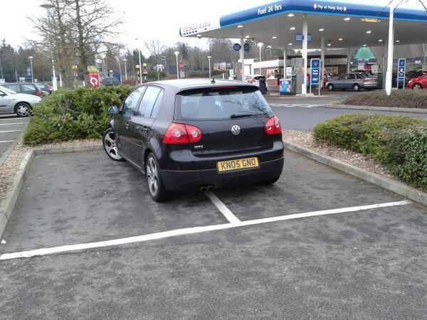
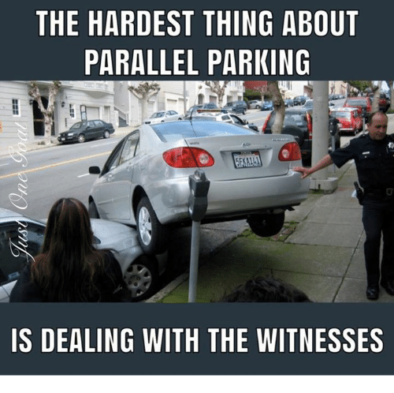
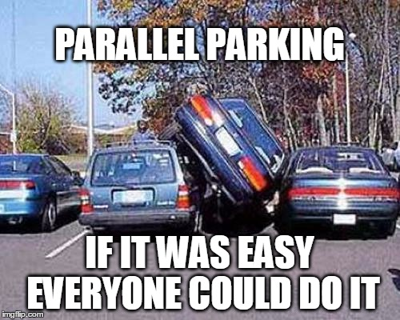
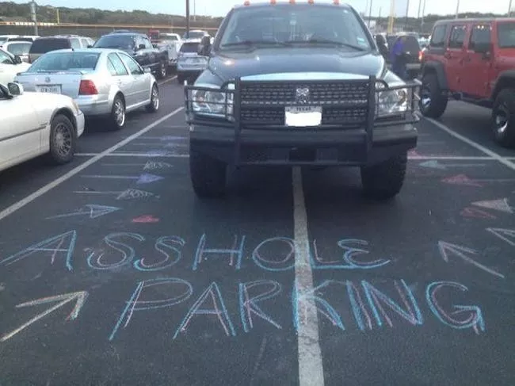
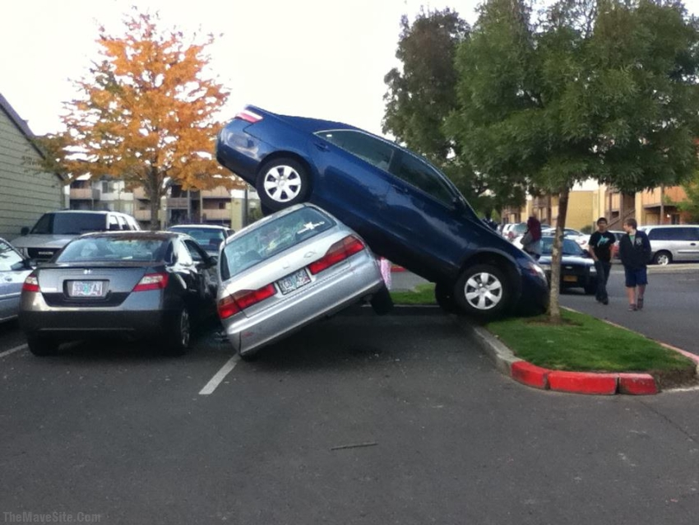
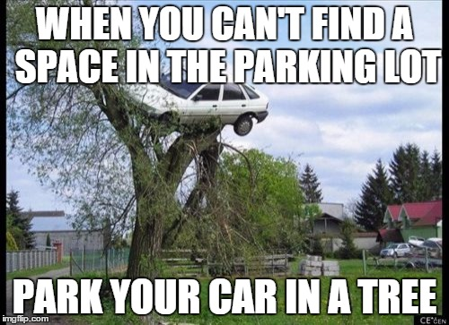
Before we continue just remember we’re here to save you from these types of people

Slide 3
What problems are you trying to solve?
Don’t you just hate it when you enter a parking structure and you drive round and round unable to find a parking space?
Well now you don’t have to!
With the iPark you can now see which spots are open and which aren’t! Thus saving you time to not do other stuff.

Slide 4
Development Process
Phase 0: Github https://github.com/adamscout162/iParkProject
Phase 1: Initial page setup (forgive us coding God, we hard coded this phase)
Phase 2: Stylistic decisions
Phase 3: Stop hard coding and use jQuery to fill up the parking spots automatically
Phase 4: Now what happens on submission
Phase 5: Set up locally host DB using phpmyadmin
Phase 6: Have frontend and server communicate

Slide 5
What does our project do?
Were you not paying attention before? We save time and stuff- duh!
Our project allows users to find available parking space in a parking structure with great ease and efficiency.
Once you select an open spot (green) it then changes its status (red) and your information (name, and spot number) is saved in out super top secret database.
You cannot take the same spot twice, otherwise you will get an error message.
Live demonstration time!

Slide 6
What future plans/current limitations do you have for this project?
Aside from world domination via Bitcoin we would like to do the following:
Implement a system that you gives you code for you to put in as you park and leave.
Have timer that counts down from when you started parking to when time for you to leave
Make the design cleaner
Implement username and password system along with password reset system.
Maybe have points and rating system
Payment options (Bitcoin and other cryptocurrency included)

Slide 7

STUDIED HARD TO GET A JOB
JUST TO REALIZE THAT TUITION MONEY WOULD’VE BEEN BETTER SPENT MINING BITCOIN

